Slide 1
Postpartum Regression:
Mitigating Postpartum Depression through Pre-Delivery Intervention
Ctrl Alt Defeat
Florian Fingscheidt, Ben Webster, & Derec Gregory

Slide 2
Postpartum Depression (PPD) is a type of depression that can occur after childbirth, causing persistent feelings of sadness, anxiety, and exhaustion.

Slide 3
Overview
01
02
03
04
Background on Health in Kansas
Exploring PPD Over Time
What Factors Contribute to PPD?
Finding Steps Forward

Slide 4
01
Health in Kansas

Slide 5
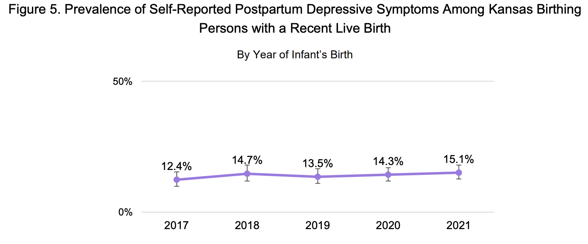
Background Information
Kansas ranks second worst (45/46) for PPD rates in the US.
(via American Health Rankings, 2023)
Since 1991, Kansas has fallen 20 places, from 8th to 28th for general healthcare by state.
(via Kansas Health Institute, 2025)
Figure 1. Graph of PPD Symptom rate in Kansas from 2017-2021. From Bureau of Epidemiology & Public Health Informatics, 2024.
Notes:
Study participants identified 52 concerns. The top four were:
Closure of rural hospitals and health care services
Lack of Medicaid expansion
Limited availability of mental health services
Low public health funding

Slide 6
Main Concerns in Kansas Health
Lack of Medicaid Expansion
Lack of Medicaid Expansion
Closure of rural hospitals
Closure of rural hospitals
Low Public Health Funding
Low Public Health Funding
Limited Mental Health Support
Kansas Health Institute, 2025
Notes:
Study participants identified 52 concerns. The top four were:
Closure of rural hospitals and health care services
Lack of Medicaid expansion
Limited availability of mental health services
Low public health funding

Slide 7
Quantizing Postpartum Depression
Edinburgh Postnatal Depression Scale is a self-administered screening for symptoms of Postpartum Depression.
Contains 10 questions such as
  I have been anxious or worried for no good reason
  I have felt sad or miserable
Scores >10 indicate a possible case of PPD, and a follow up visit is recommended.
Scores >13 indicates a diagnosable case of Postpartum Depression.

Slide 8
02
Postpartum Depression Over the Course of Pregnancy

Slide 9
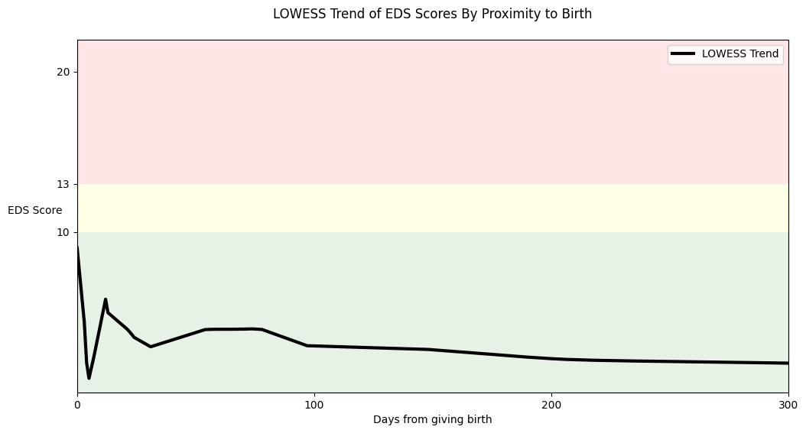

Slide 10
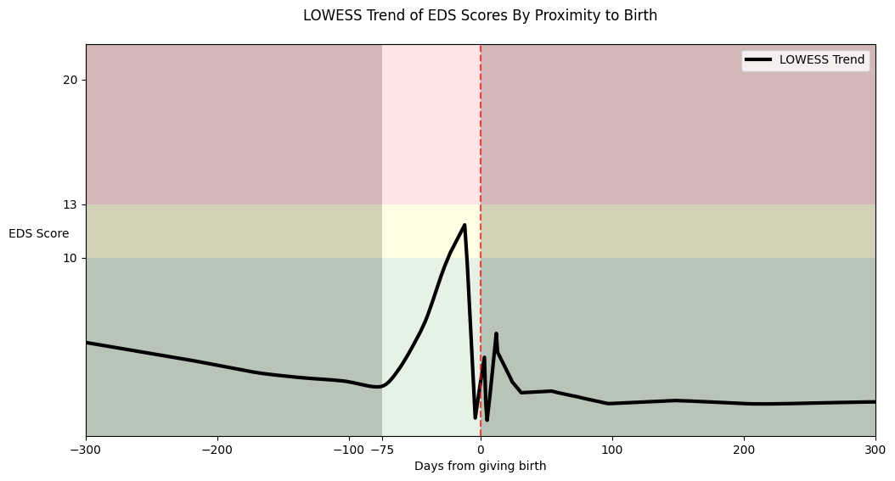
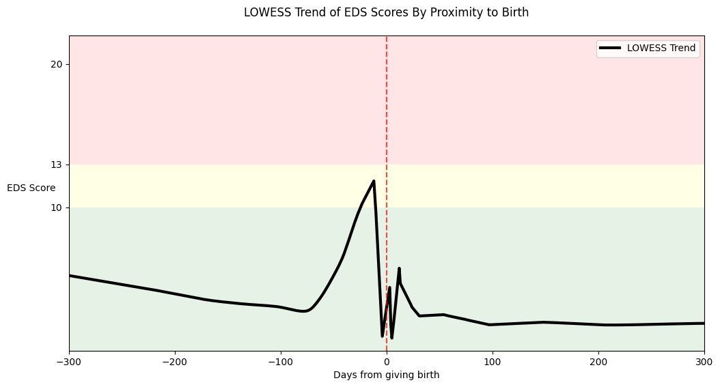

Slide 11
03
What Influences PPD?
Notes:
Derec

Slide 12
What links to EDS Scores?
Of the Social Determinant questions given to patients who also completed the EDS screening, we ran Linear Regressions on 14 questons.
Of these 14 regression models, we found that 10 were statistically significant.
What we are looking for:
  Something Actionable
  Protective Factors

Slide 13
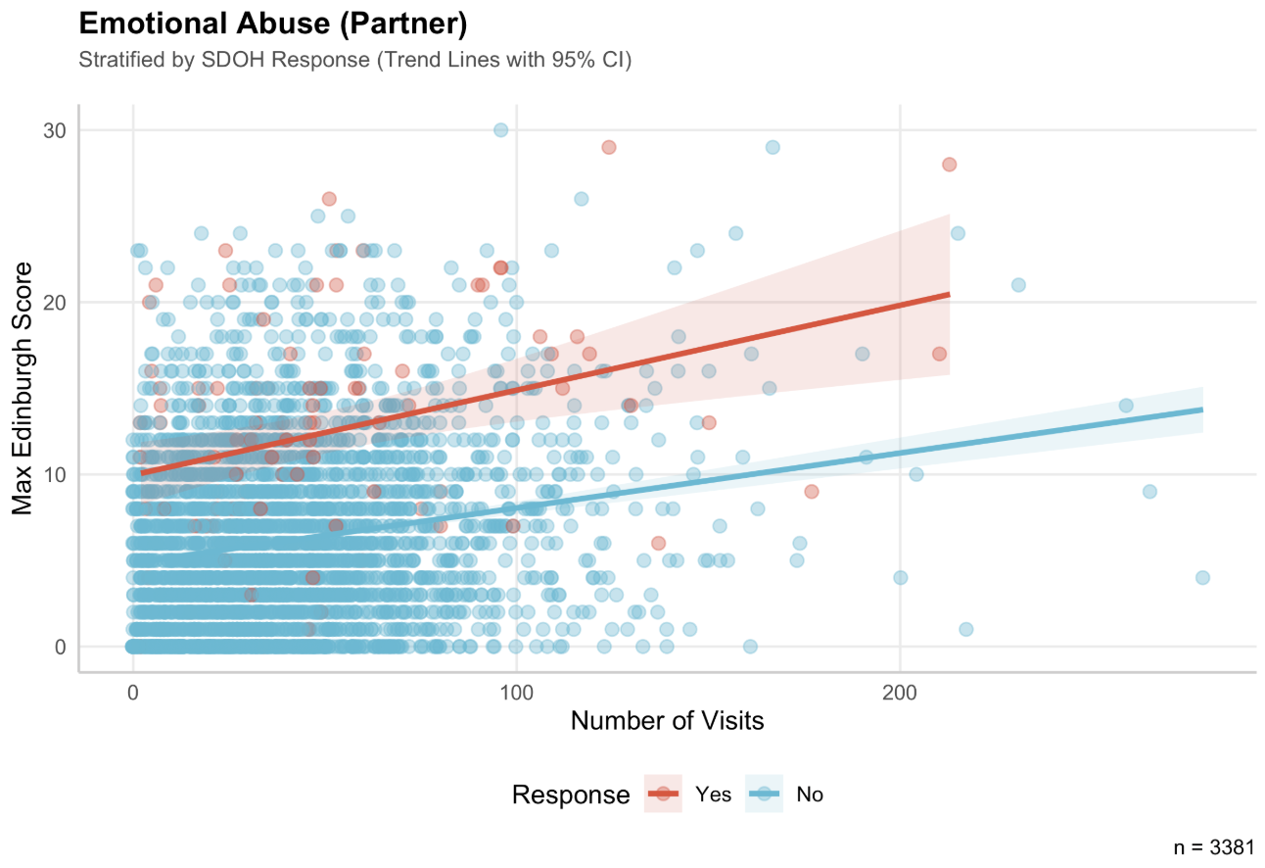
Weight: 6.301

Slide 14
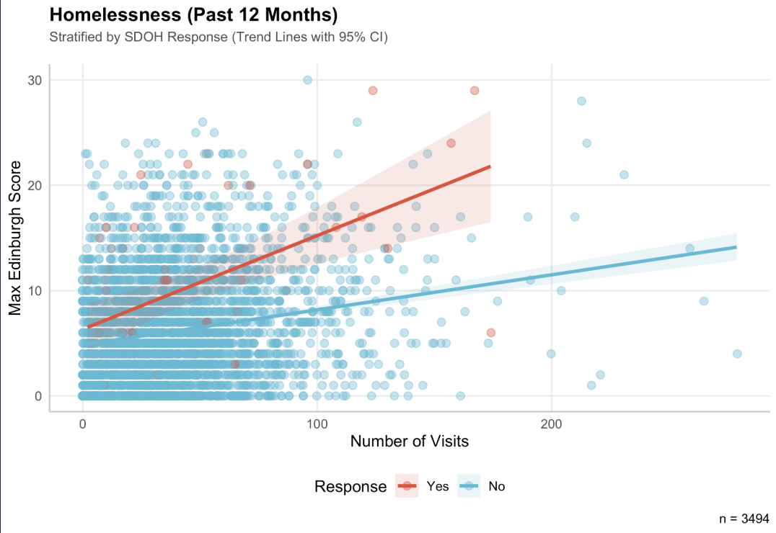
Healthcare research
Weight: 4.102
Organization
Financing
Quality
Mercury is the closest planet to the Sun and the smallest of them all
Venus has a beautiful name and is the second planet from the Sun
Despite being red, Mars is actually a cold place. It’s full of iron oxide dust

Slide 15
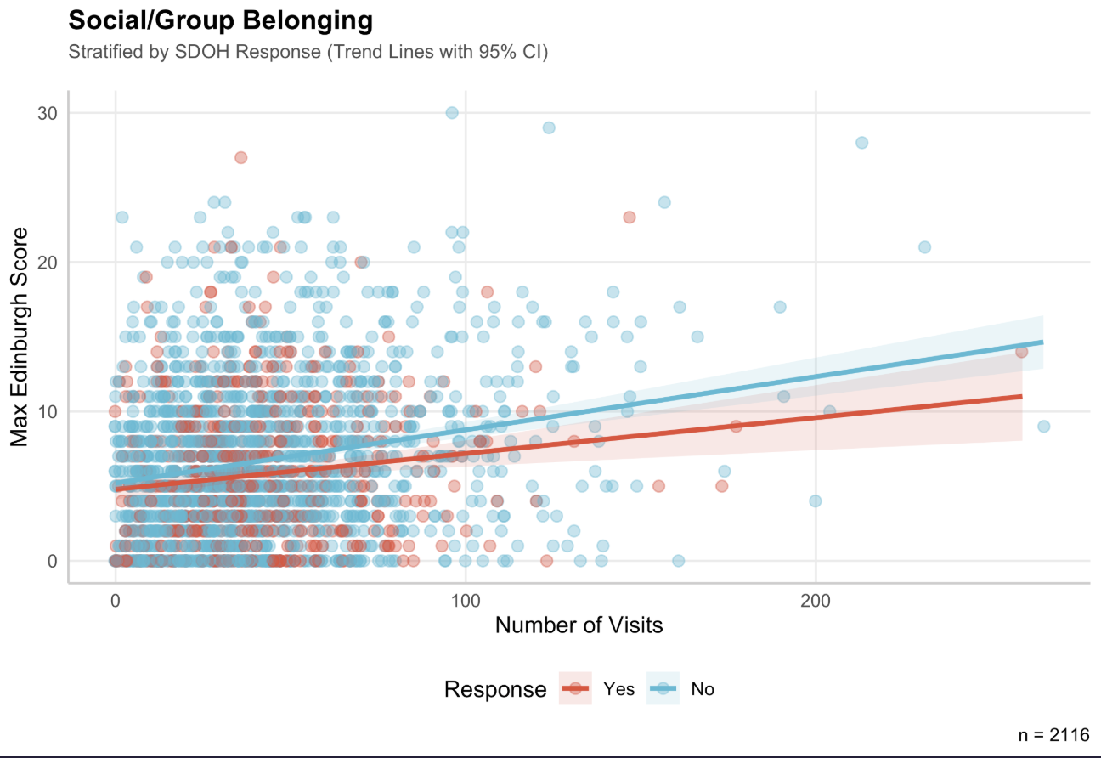
Weight: -0.964
Medical
Mercury is the closest planet to the Sun
Clinic
Saturn is a gas giant and has several rings

Slide 16
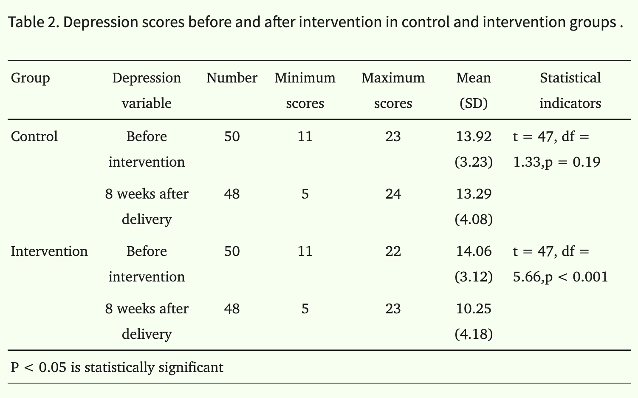
What Does This Mean?
Having a social outlet and space of belonging can help prevent Postpartum Depression.
Peer support is effective in the mitigation of Postpartum Depression (Kamalifard et al., 2013).
Figure 1. A table showing Edinburgh Postpartum Depression Scores of patients in the control vs experimental group. From National Library of Medicine, by Mahin Kamalifar et al., 2013
Notes:
Samples who gained a score of 11-23 in Edinburgh depression survey were entered to the study.

Slide 17
04
Finding Steps Forward

Slide 18
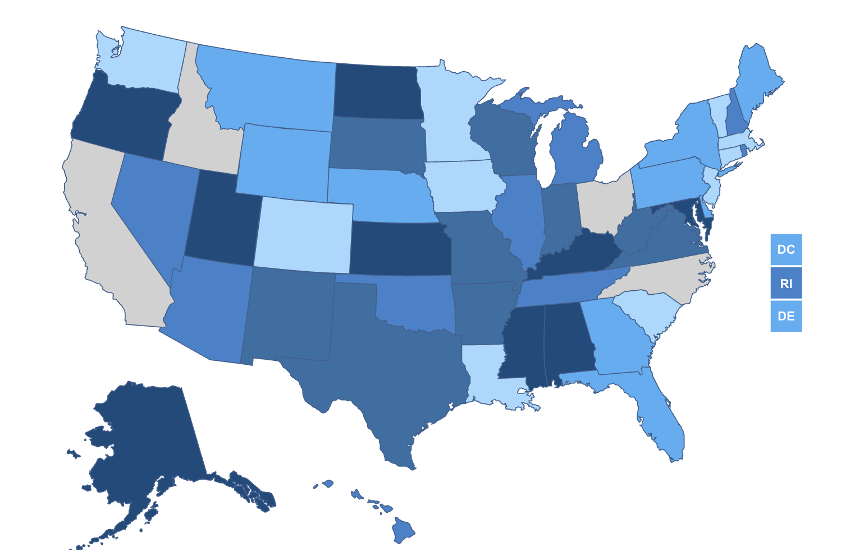

What We Know
Postpartum Depression by State
Kansas ranks very low in terms of national mental health ranking, especially in PPD.
Patients in the final 75 days of pregnancy experience increasing levels of PPD symptoms.
Peer support is effective in preventing and combatting PPD.
Figure 1. A map of the United States displaying PPD rate by state. From United Health Rankings, 2023.

Slide 19
Our Proposal
To combat Kansas’s growing problem of Postpartum Depression, Stormont Vail Health should invest in programs to provide pregnant patients with support groups in the final 75 days of pregnancy.

Slide 20
Bibliography
Explore postpartum depression in Kansas: AHR. Explore Postpartum Depression in Kansas | AHR. (n.d.). https://www.americashealthrankings.org/explore/measures/postpartum_depression/KS
Kamalifard, M., Iraji-Iranagh, R., Yavarikia, P., & Babapour-Kheiroddin, J. (2025). Peer support as a preventive intervention for postpartum anxiety: A single-blind randomized clinical trial. Journal of Research in Clinical Medicine, 13, 33468. https://doi.org/10.34172/jrcm.025.33468
Kansas Pregnancy Risk Assessment Monitoring System ... (n.d.). https://www.kdhe.ks.gov/ArchiveCenter/ViewFile/Item/2841
Kovach, K. (2025, September 29). What happened to health in Kansas?. Kansas Health Institute. https://www.khi.org/articles/what-happened-to-health-in-kansas-reports/

Slide 21
Questions?

